Slide 1
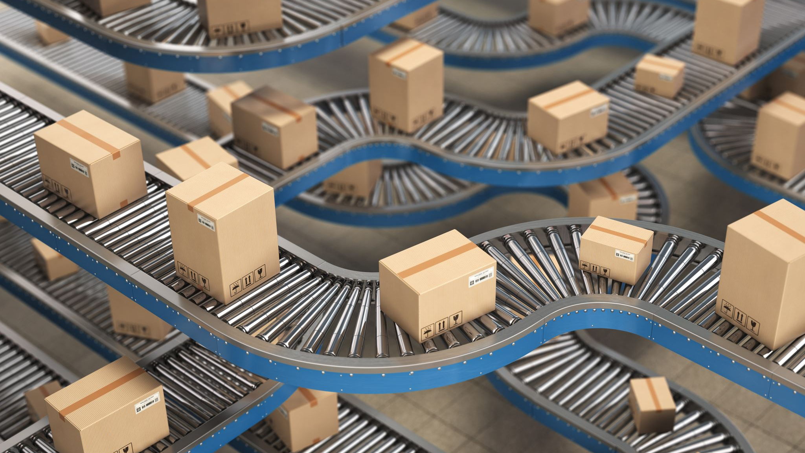
GoFast: Revolutionizing the Delivery Experience

Slide 2
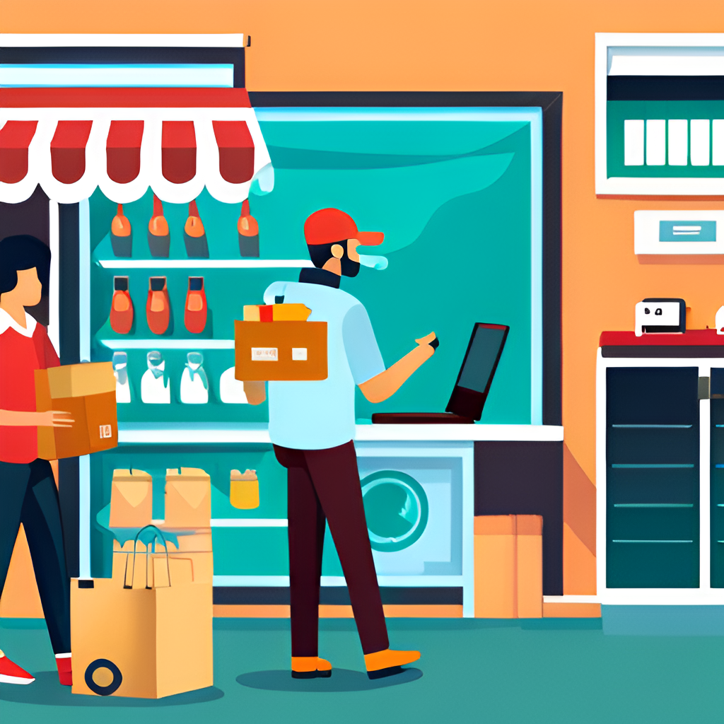
Introduction
The project of a delivery website aims to provide customers with a convenient and efficient way to order and receive goods from various stores and restaurants.
The website will offer a user-friendly interface that allows customers to browse through different categories, select items, and place orders with just a few clicks.

Slide 3

Context and Justification
The delivery field is a popular field nowadays. It is broad all over the world as it is really efficient.
Delivery is really important as it facilitates people life. It helps is business, it helps in selfuse, it benefit people who are very occupy and serve as an employement for others.
Some delivery service nowadays are
DHL
UBER EAT
DELIVEROO

Slide 4

Project Specification
To ensure the website runs smoothly and efficiently, we will use cutting-edge technology such as cloud computing, machine learning algorithms, and data analytics.
This will allow us to optimize delivery routes, predict demand, and personalize the user experience based on previous orders and preferences.

Slide 5

Marketing Strategy
To attract customers and increase brand awareness, we will implement a multi-channel marketing strategy that includes social media advertising, influencer partnerships, and targeted email campaigns.
We will also offer promotions and discounts to first-time users and loyal customers, as well as collaborate with local businesses to expand our reach and offer exclusive deals.

Slide 6

Challenges
While the project has great potential, there are several challenges that we must overcome, such as ensuring timely and accurate deliveries, managing inventory and stock levels, and maintaining customer satisfaction.
To address these challenges, we will hire a dedicated team of logistics experts, implement inventory management software, and conduct regular customer feedback surveys to improve our service.

Slide 7
Colour Charter
Yellow
Black
White
Violet
Green
Dark blue
Brown

Slide 8

Conclusion
In conclusion, the project of a delivery website has the potential to revolutionize the way customers order and receive goods from various stores and restaurants.
With a user-friendly interface, innovative technology, and a comprehensive marketing strategy, we aim to provide customers with a seamless and enjoyable experience while supporting local businesses and communities.

Slide 9
Group member
Lionel Mayi Mayi
Ebong Etongue Eva Carole

